Slide 1

Design thinking for robotics
Designing and testing a bionic arm for a limb different client

Slide 2
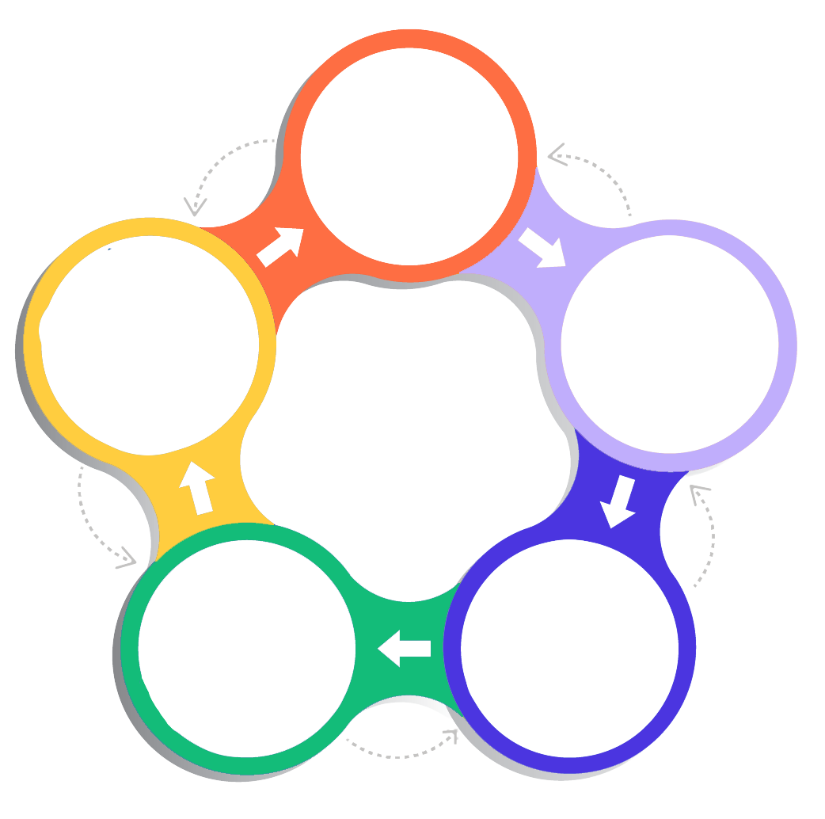
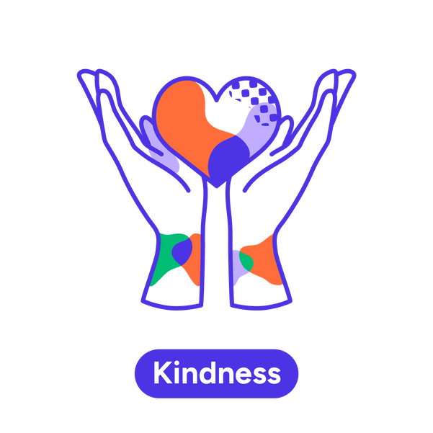
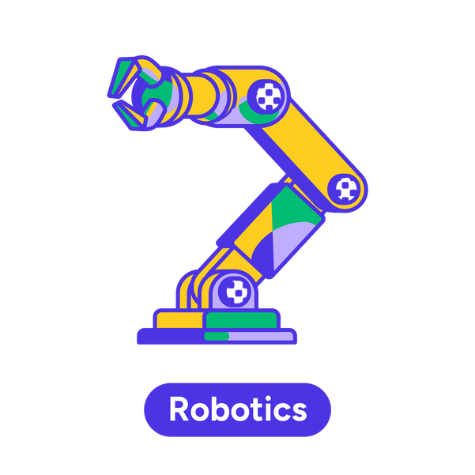
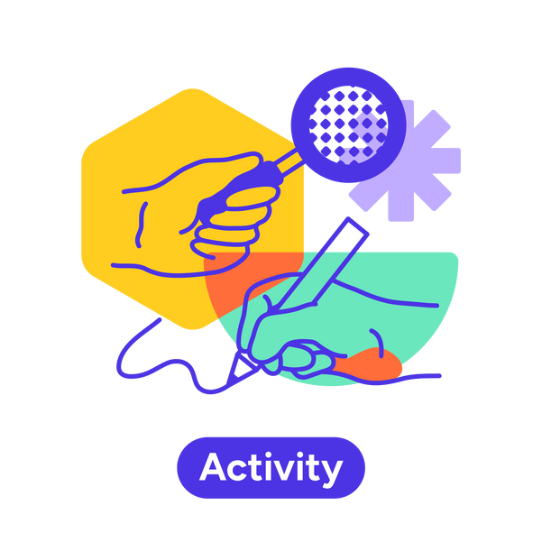
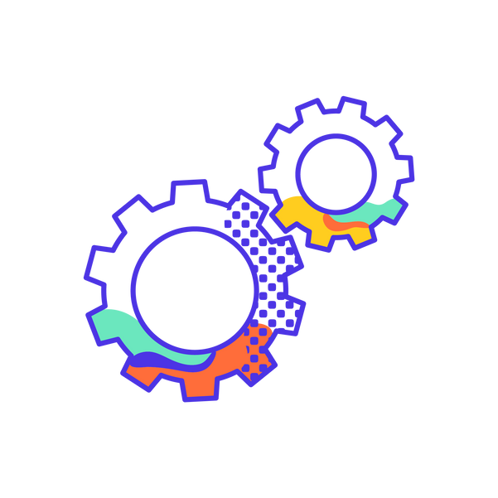

Iteration is key…
Draw inspiration and ideas before each cycle from either:
What are the needs of your client?
Nature
Visit the biomimicry library
Human biology
Visit the human arm app
Smart technology
Visit the myosensors module
SCAMPER wheel
Visit the SCAMPER wheel
Complete the challenges set by your client.
Empathise
What could be improved?
Test
Define
Draw inspiration from nature and the human body to generate new ideas.
Update your tool.
Prototype
Ideate
Notes:
Ideate
The modules are designed to inspire students in the iterative design process by giving them examples of movement and control of limbs from biology and nature.
The biomimicry library. The library directs the students to consider how nature has developed its own creative engineering solutions that we can learn from.
OR
The human arm app. The app allows the students to observe and connect how three different organ systems work together to give a human arm its functions: bones, muscles and nerves.
OR
Myo sensors. Students connect and test myosensors. These sensors detect the electrical signals generated in the students muscles (input) and translate them into robotic movement (output).
Students consider the previous performance of their tool, feedback from peers, and ideas from the above modules to plan the modifications or redesign of their tool. The students use the design template to consolidate their ideas and sketch out their designs.
The students may also use the SCAMPER wheel to be randomly prompted for ideas to improve their design. The activity prompts the students to approach iteration of their design from different perspectives.
Prototype
Students build and or modify their tools.
- The students may need to rebuild the original tool if they have been deconstructed between lessons.
- The prototyping tub of lego is stocked for this phase. The materials in the prototyping tubs can be flexibly utilised between groups and do not need to return to a particular tub.
Test
Students test their tool by attempting the challenges set by their client. The challenges progress in difficulty.
Students use the equipment provided or connect digitally to attempt the challenges for:
- Baz
- Zahara, and
- Tahlia (T-Rex game as offline chrome, or snake, or tetris)
Define
Students provide peer feedback on how the tool functioned relative to the clients needs. Feedback is conducted as pairs between two students from different groups.

Slide 3
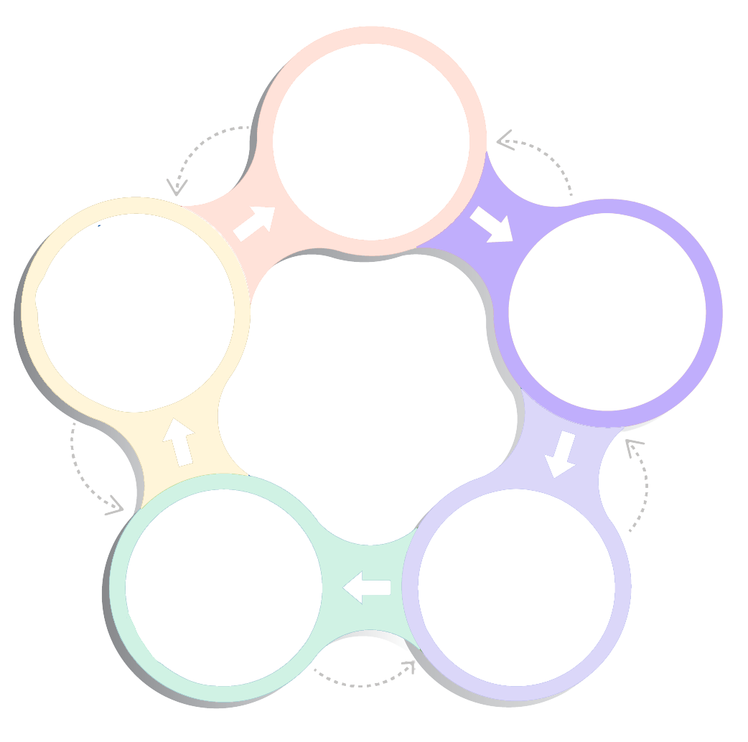
Reflection and feedback
Think
1
Which parts of your tool were:
Useful for completing the challenges.
5 min
What parts of your tool were:
Not required.
Improvable
Replaceable
Empathise
2
Pair
Test
Define
Find someone from another team
3
Share
Share and discuss with your pair your reflections. Remember to be kind, specific and helpful.
Prototype
Ideate
Notes:
Students seek and give feedback by the think pair share format. Think
They must consider what was useful about their tool AND what could be improved or replaced. To be clear, a part of a tool that was useful may also be something that could be modified or replaced.
Pair
They find someone not in their design group
Share The students share their thoughts on their own designs with each other, and seek feedback (that is kind, specific and helpful)

